Slide 1
SUPER UPDATE Integration of snRNA atlases of the adult human midbrain: Benchmarks and Label Hierarchy

Slide 2
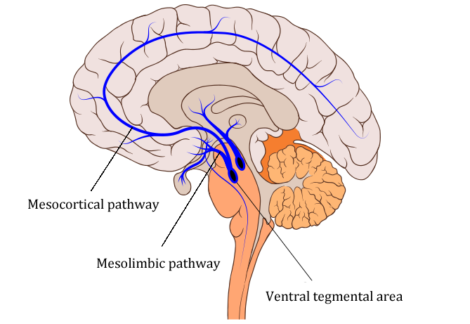
Ventral Midbrain
Role in:
Cognition
Reward system
Regulation of emotion, motivation and behavior
Problem: High heterogenity, low sensitivity

Slide 3
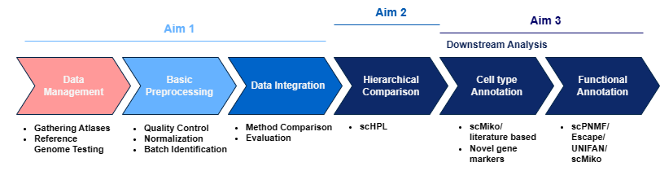
Recap: Original Goals
Integrate multiple atlases into one unified human (ventral) midbrain atlas
Determine hierarchical relations between previously identified cell types by the authors of the atlases
Determine (new) cell types, functions and potential marker genes

Slide 4
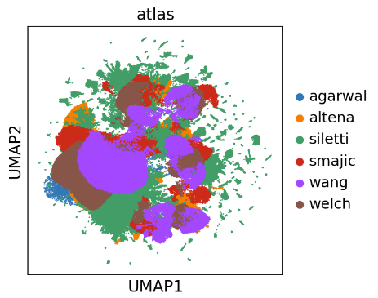
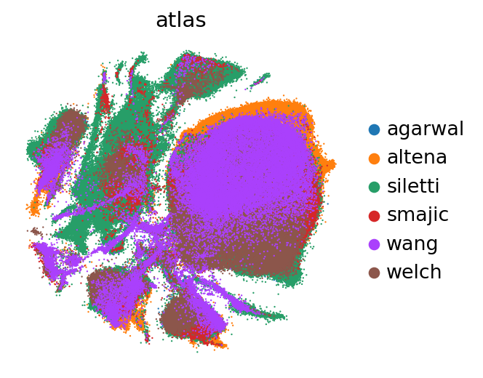
Previously
Integration methods to evaluate: scVI, Harmony and Scanorama

Slide 5
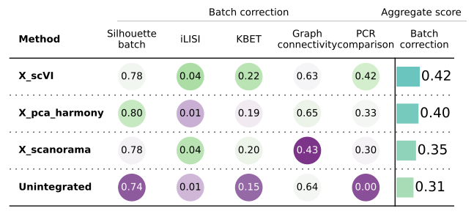
Initial evaluation
Hyperparameter tuning
# High-Variance Genes
# Latent Features
# Hidden Layer
# Hidden Nodes
Steuernagel, L., Lam, B.Y.H., Klemm, P. et al. HypoMap—a unified single-cell gene expression atlas of the murine hypothalamus. Nat Metab 4, 1402–1419 (2022).

Slide 6
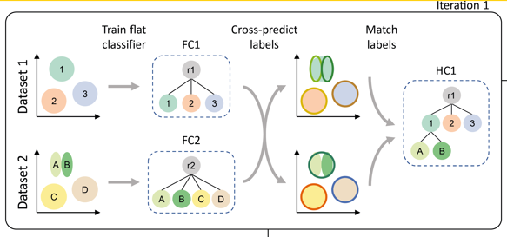
Label harmonization with scHPL
Problem: Unique labels, specific resolution levels and no annotation
Iteratively train classifier on new dataset
Labeled data only for hierarchy tree construction
Harmonize on lowest level
Michielsen, L., Reinders, M.J.T. & Mahfouz, A. Hierarchical progressive learning of cell identities in single-cell data. Nat Commun 12, 2799 (2021)

Slide 7
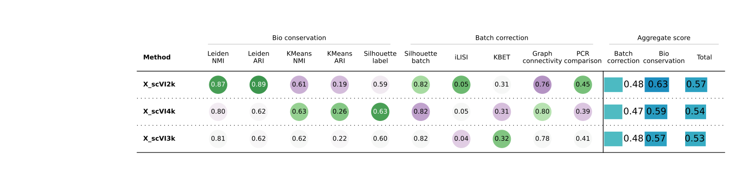
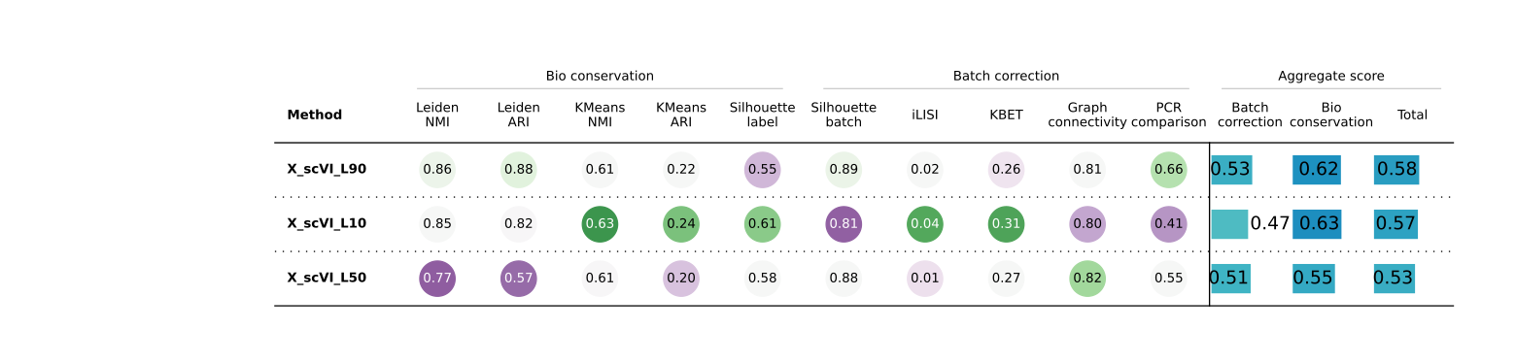
# High-Variance Genes and Latent Features

Slide 8
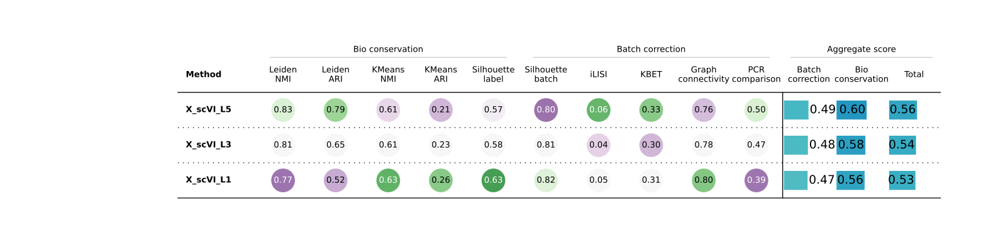
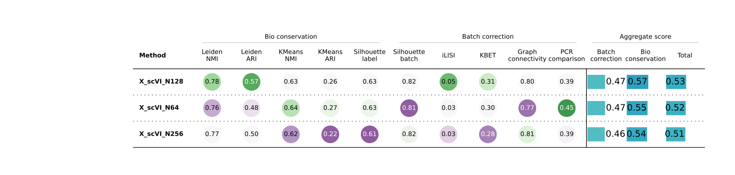
# Hidden Layer and Nodes

Slide 9
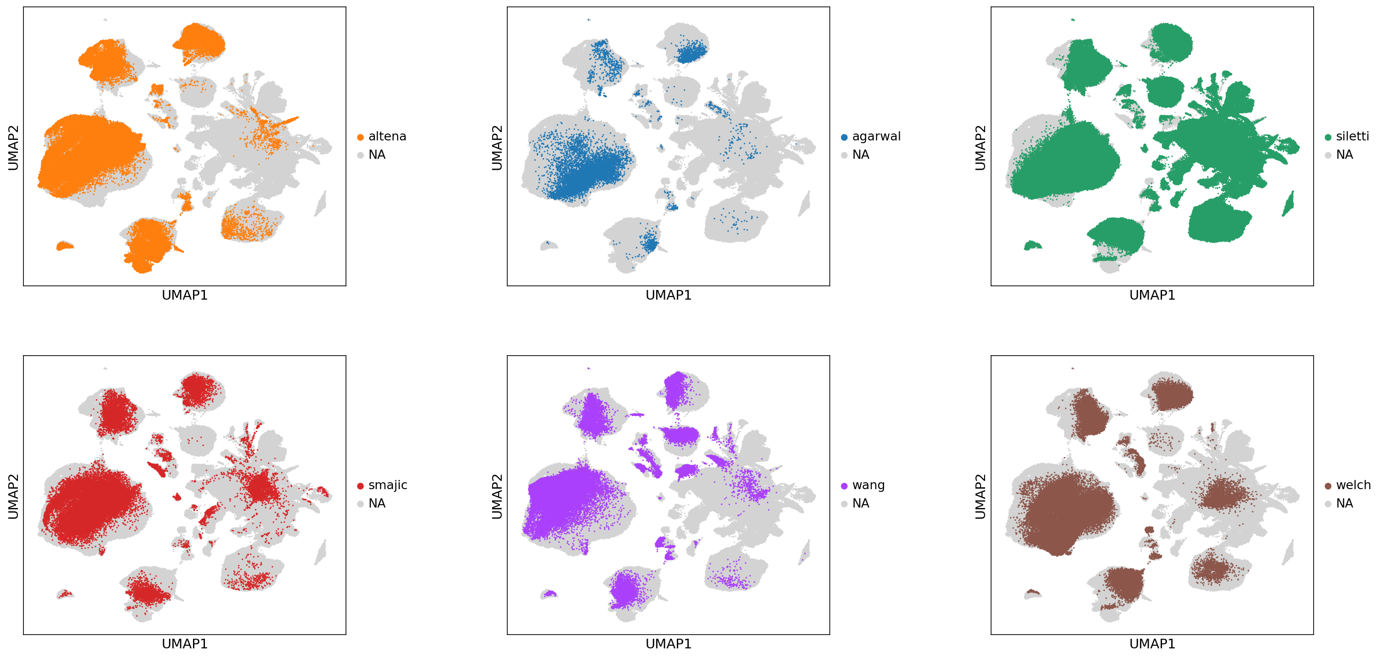
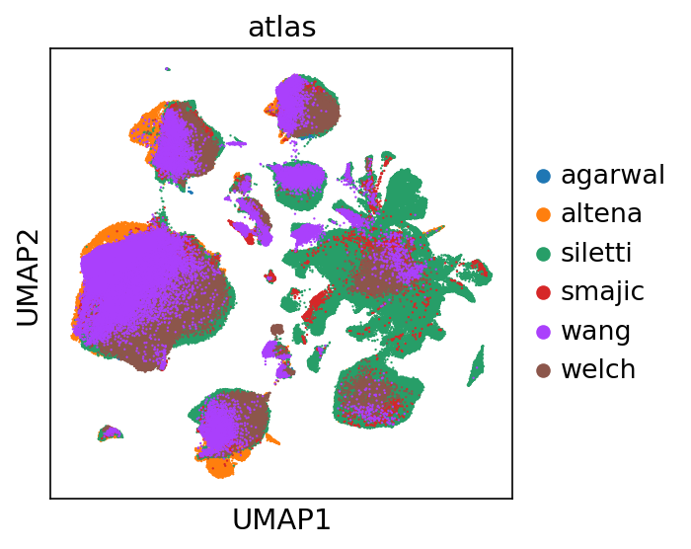
Whole dataset integration
Hyperparameter values:
2000 HVGs
90 Latent features
5 Hidden layers
128 Hidden nodes

Slide 10
Comparison hyperparameter tuning

Slide 11
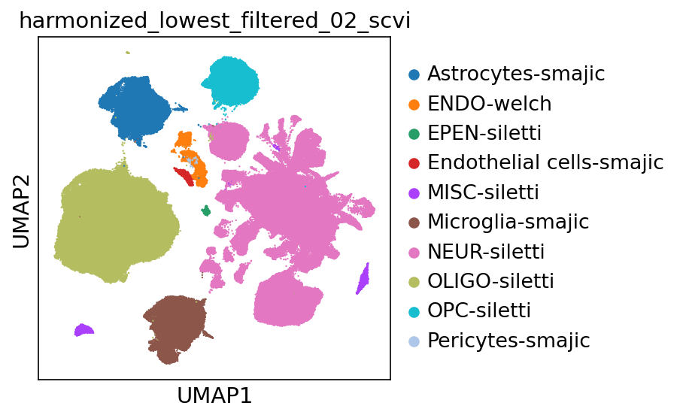
Lowest label prediction
Use Harmonized labels to train K-NN classifier
Including a threshold of 0.2 for unknown -> filter out
~520000 -> ~500000 cells

Slide 12
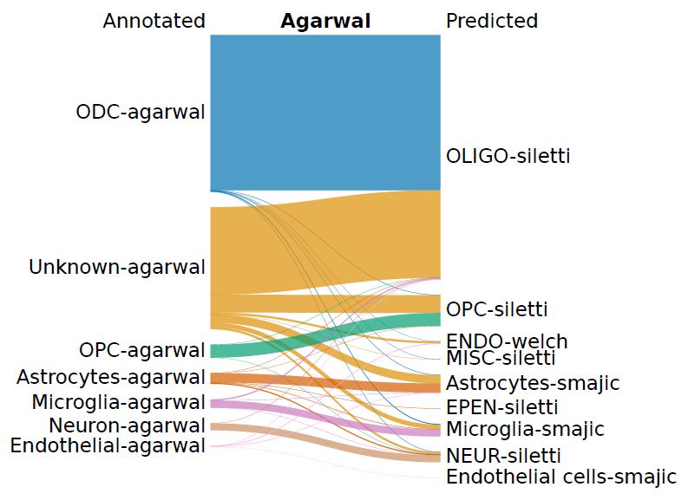
Lowest label prediction
Included intronic region mapping resulted in less filtered cells and reclassification

Slide 13
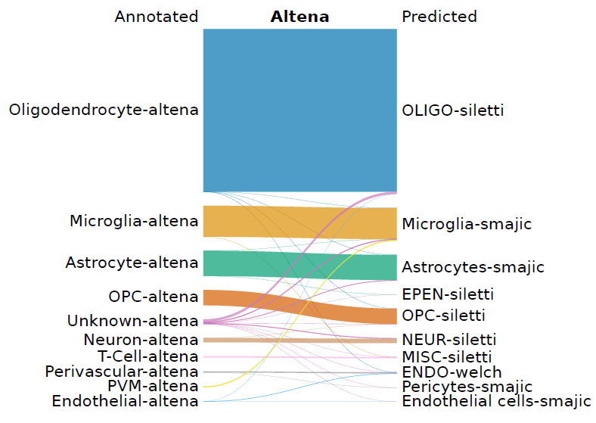
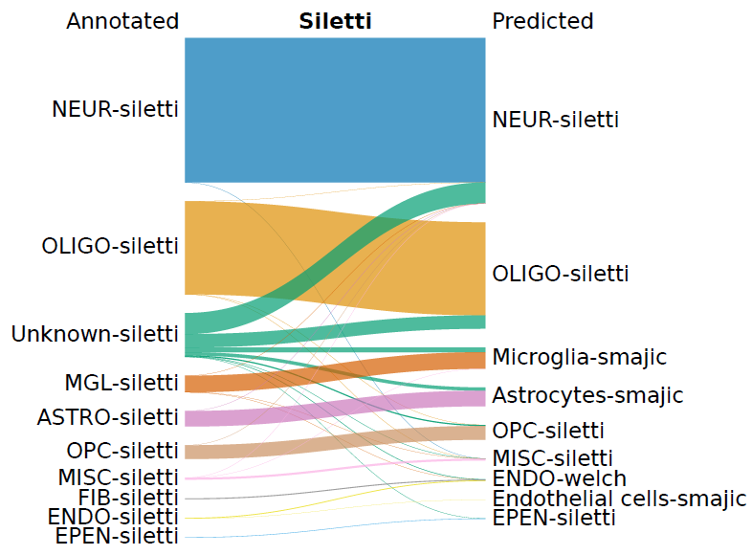
Lowest label prediction

Slide 14
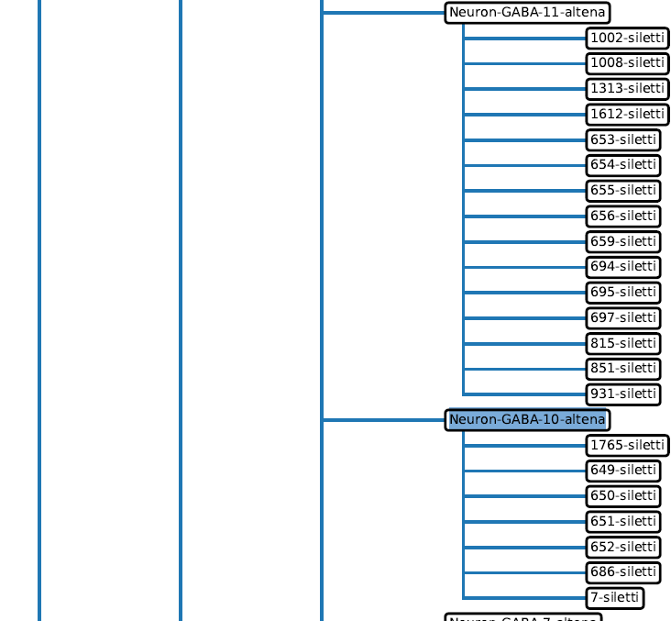
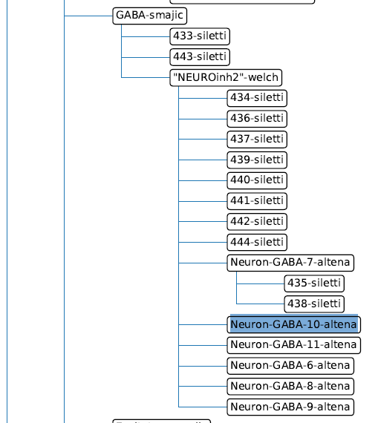
Neuron-only hierarchy tree
Only use cells that have original neuron label AND is predicted as neuron (~130000 cells)
Med resolution: highest level except for Siletti (still contained labels with many cells)
High resolution: highest level for all datasets
VS

Slide 15
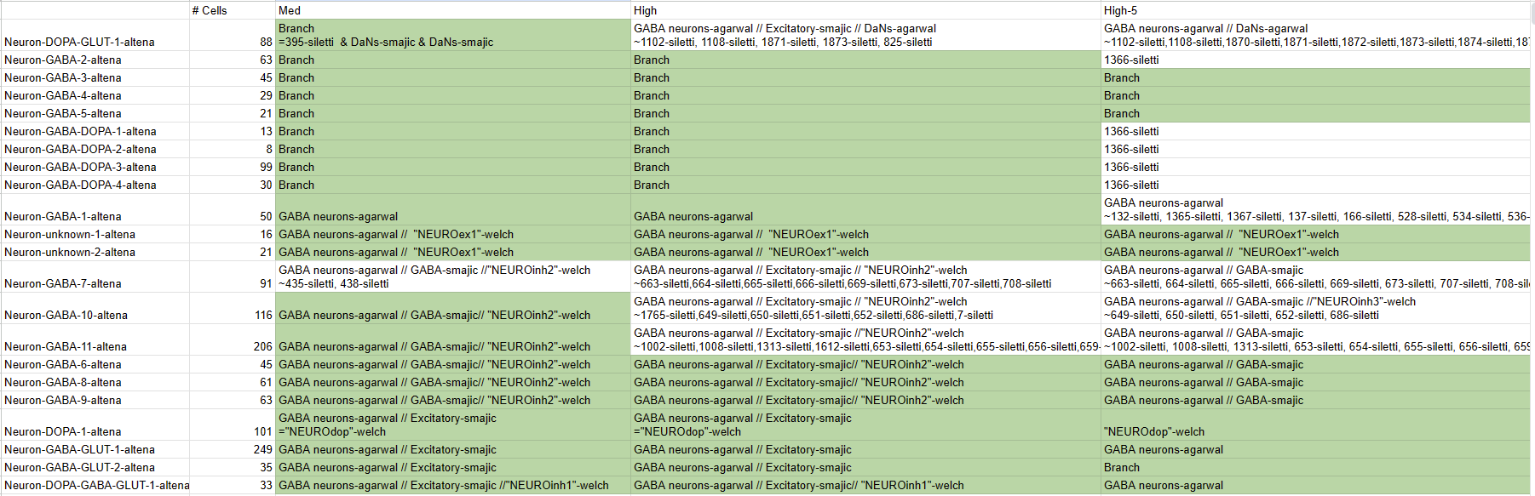
VTA-specific subtypes (van Regteren Altena)
Green: Leaf
//: branch path to Altena label
=: identical label, ~:sublabels

Slide 16
VTA-specific subtypes (van Regteren Altena)
Green: Leaf
//: branch path to Altena label
=: identical label, ~:sublabels

Slide 17
Acknowledgements
Basak Lab
Onur Basak
Tiziana Hey
Abdool Al-Khaledi
Cecile Herbermann
Hol Lab
Anna van Regteren Altena
Others
Kimberly Siletti

Slide 18
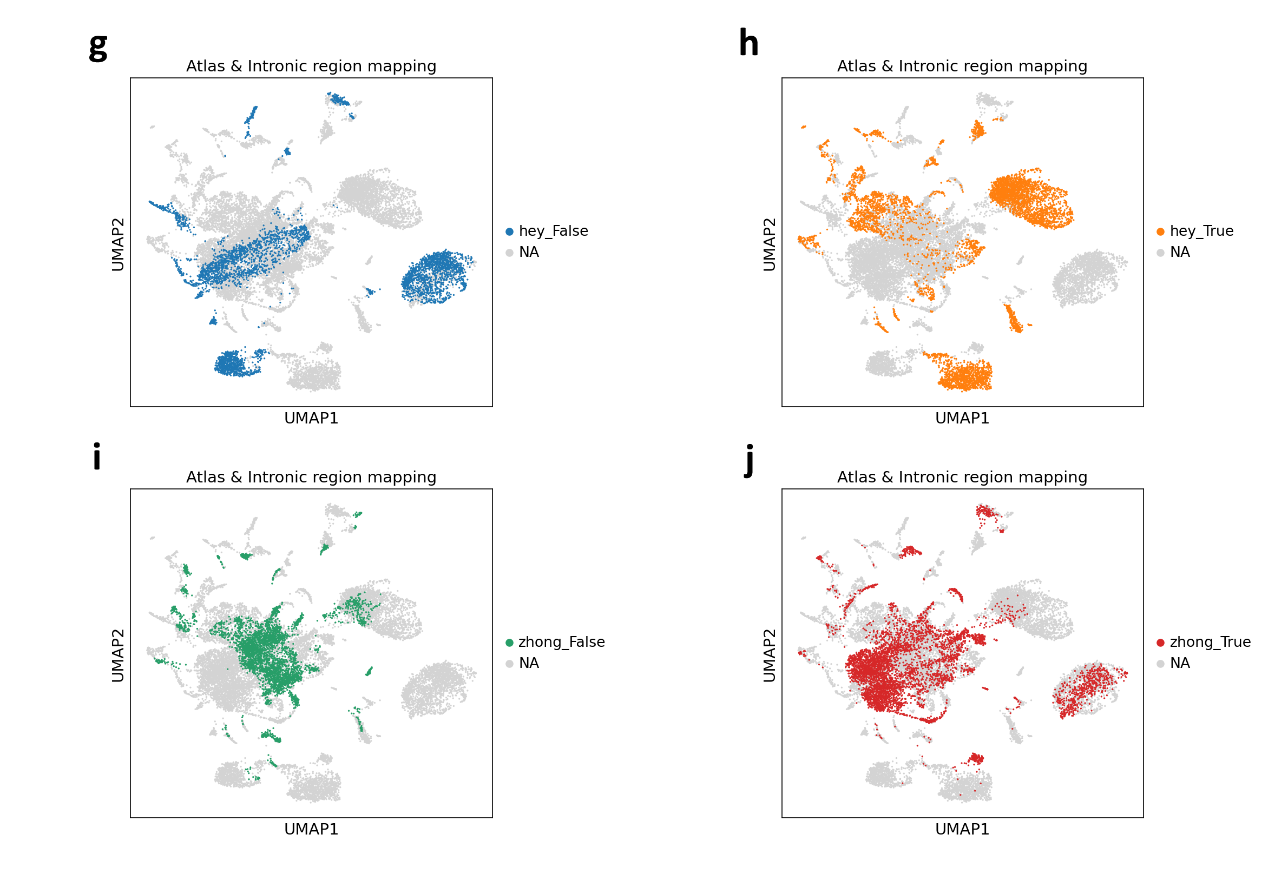
More tests: intronic mapping regress and highly-variable genes

Slide 19
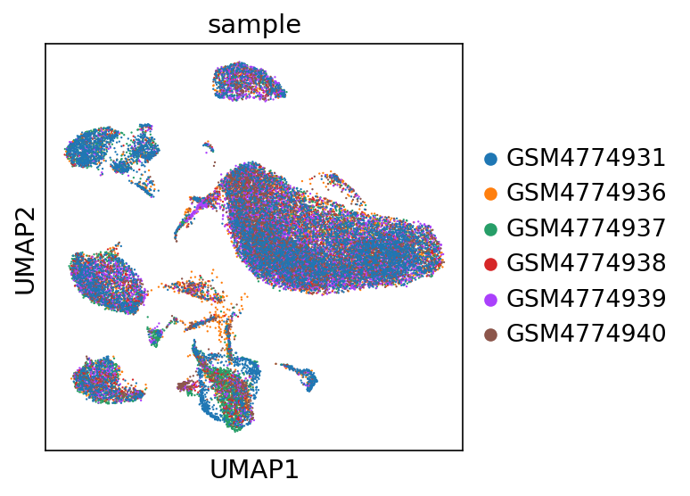
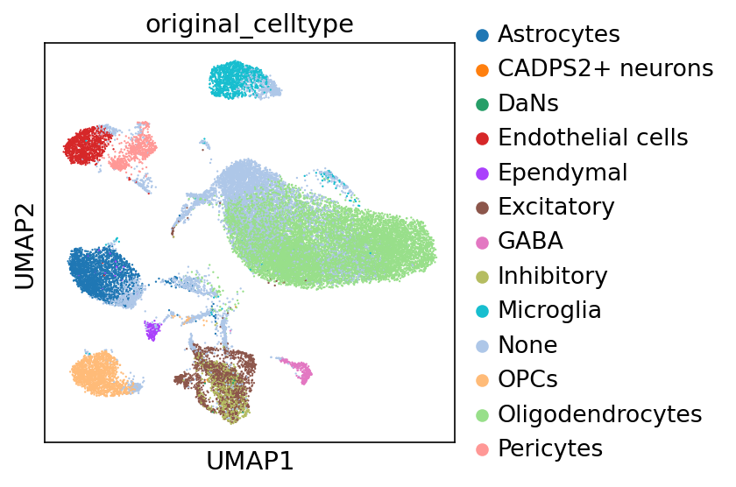
Smajic atlas

Slide 20
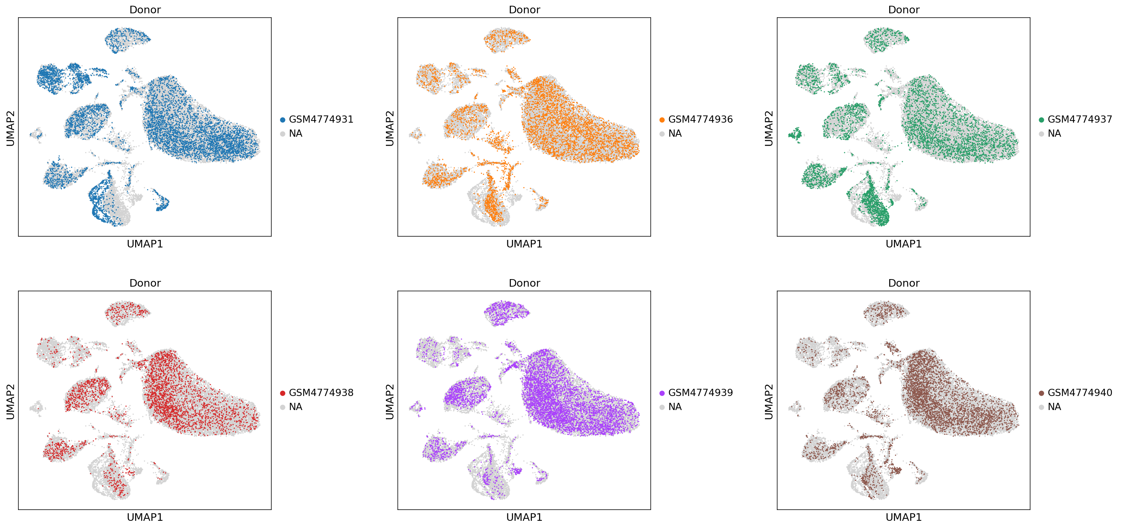
Smajic samples

Slide 21
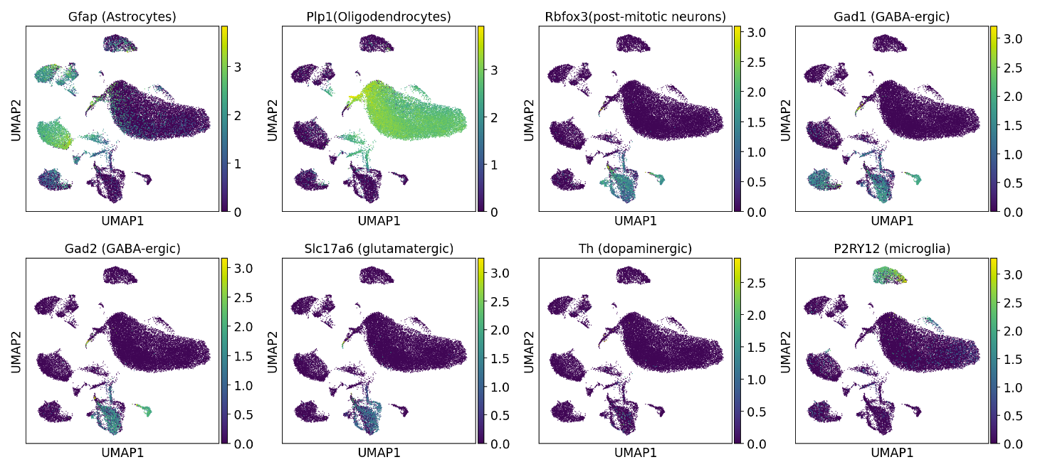
Smajic markers

Slide 22
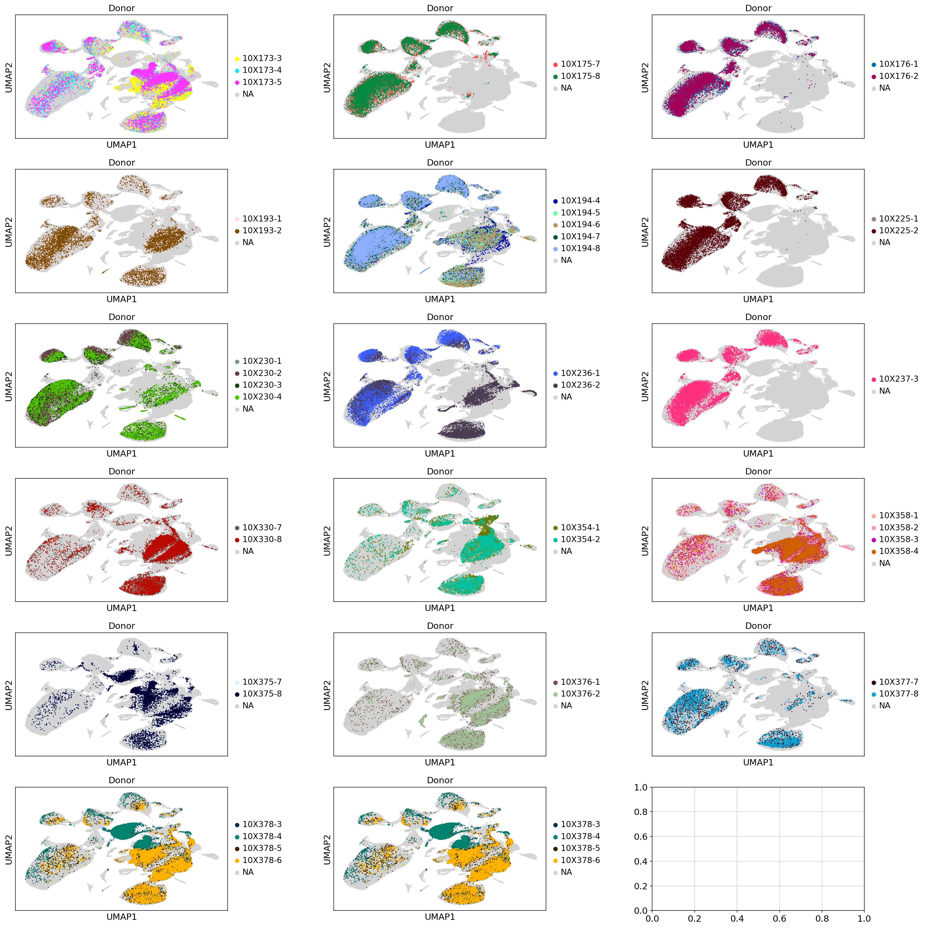
Siletti samples

Slide 23
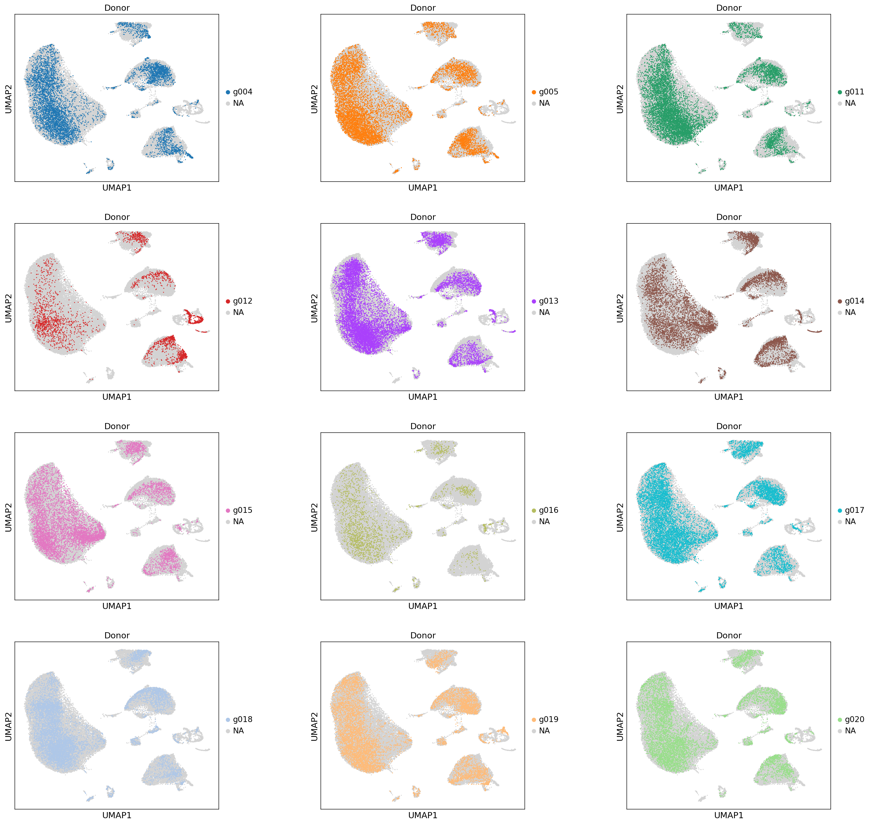
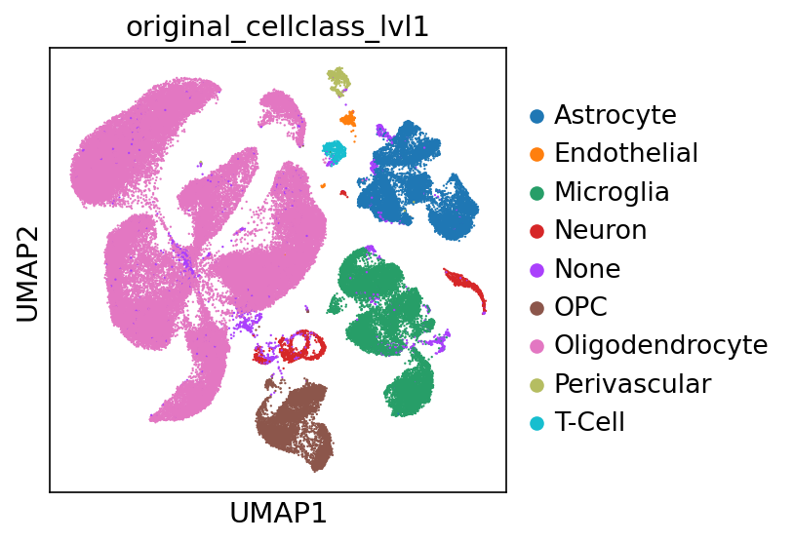
Altena samples

